Slide 1

Presentation Topic: DHCP/DHCPv6 Course Title:Computer Networks Course Code:ICT-3201
Presented By :
Suparna Rani Bristy
ID:IT-22013
Department of Information and Communication Technology,
MBSTU
Supervised By :
Dr. Nazrul Islam
Associate Professor,
Department of Information and Communication Technology,
MBSTU

Slide 2
What is DHCP
DHCP means Dynamic Host Configuration Protocol.
It gives IP addresses automatically to computers.
It works on IPv4 networks.
It helps devices connect to the Internet easily.

Slide 3
Why DHCP is Used
Without DHCP, we must set IPs manually.
Manual setup is slow and may cause mistakes.
DHCP makes the process fast and automatic.
Used in homes, schools, and offices.

Slide 4
How DHCP Works
DHCP has four steps called DORA:
Discover – Client asks for IP.
Offer – Server offers IP.
Request – Client asks to use it.
Acknowledge – Server approves it.

Slide 5
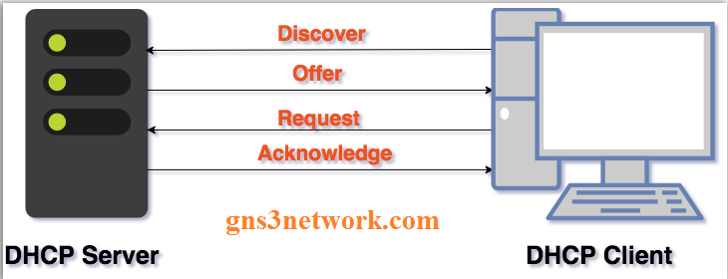
DORA Process Diagram

Slide 6
What DHCP Gives to Client
IP address
Subnet mask
Default gateway
DNS server address
Lease time (valid duration)

Slide 7
DHCP Server and Client
DHCP Server: Sends IP and settings.
DHCP Client: Receives and uses them.
Example: Router = server, laptop = client.

Slide 8
Example of DHCP in Real Life
When we connect to Wi-Fi, our phone gets an IP automatically.
That’s because the router uses DHCP.
The router assigns an IP address, subnet mask, gateway, and DNS to the device.
We can connect to the Internet without entering any settings manually.

Slide 9
Problems with Old DHCP (IPv4)
IPv4 has limited addresses.
With more devices today, many networks face IP shortages.
Cannot handle new IPv6 networks.
It was designed for older Internet systems.
DHCPv6 is needed for newer, faster, and more secure IPv6 networks.

Slide 10
What is DHCPv6
DHCPv6 = DHCP for IPv6 networks.
Supports 128-bit IPv6 addresses.
Can give IPv6 address, DNS, and prefix.
Works better for modern Internet devices.

Slide 11
How DHCPv6 Works
Steps in DHCPv6 are called SARR:
Solicit – Client asks for info.
Advertise – Server offers details.
Request – Client requests address.
Reply – Server confirms it.

Slide 12
How DHCPv6 Works
Feature | DHCP (IPv4) | DHCPv6 (IPv6)
Address Size | 32-bit | 128-bit
Process | DORA | SARR
Uses | Broadcast | Multicast
Default Gateway | Given by server | Given by router
Version | IPv4 | IPv6 only

Slide 13
Advantages of DHCPv6
Handles many devices easily
Gives unique addresses automatically.
Works with stateful and stateless modes.
Faster and more secure network setup.

Slide 14
DHCPv6 in Daily Life
New routers use DHCPv6 to assign IPv6 addresses automatically.
Works with for smartphones and IoT devices.
Internet providers also use it for home connections.
Helps manage a large number of connected devices efficiently.

Slide 15
Benefits of Using DHCP
Saves time and reduces errors.
Easy for network admins to manage.
Makes IP assignment automatic.
Keeps the network organized.

Slide 16
Summary
DHCP → IPv4, DHCPv6 → IPv6.
Both give IP addresses automatically.
Make network setup simple and fast.
Important for every modern network.

Slide 17
Thank you

